Slide 1
University of Manchester
Raspberry Jam
March 2014

Slide 2
Health and Safety Messages
(yay)

Slide 3
Last time…

Slide 4
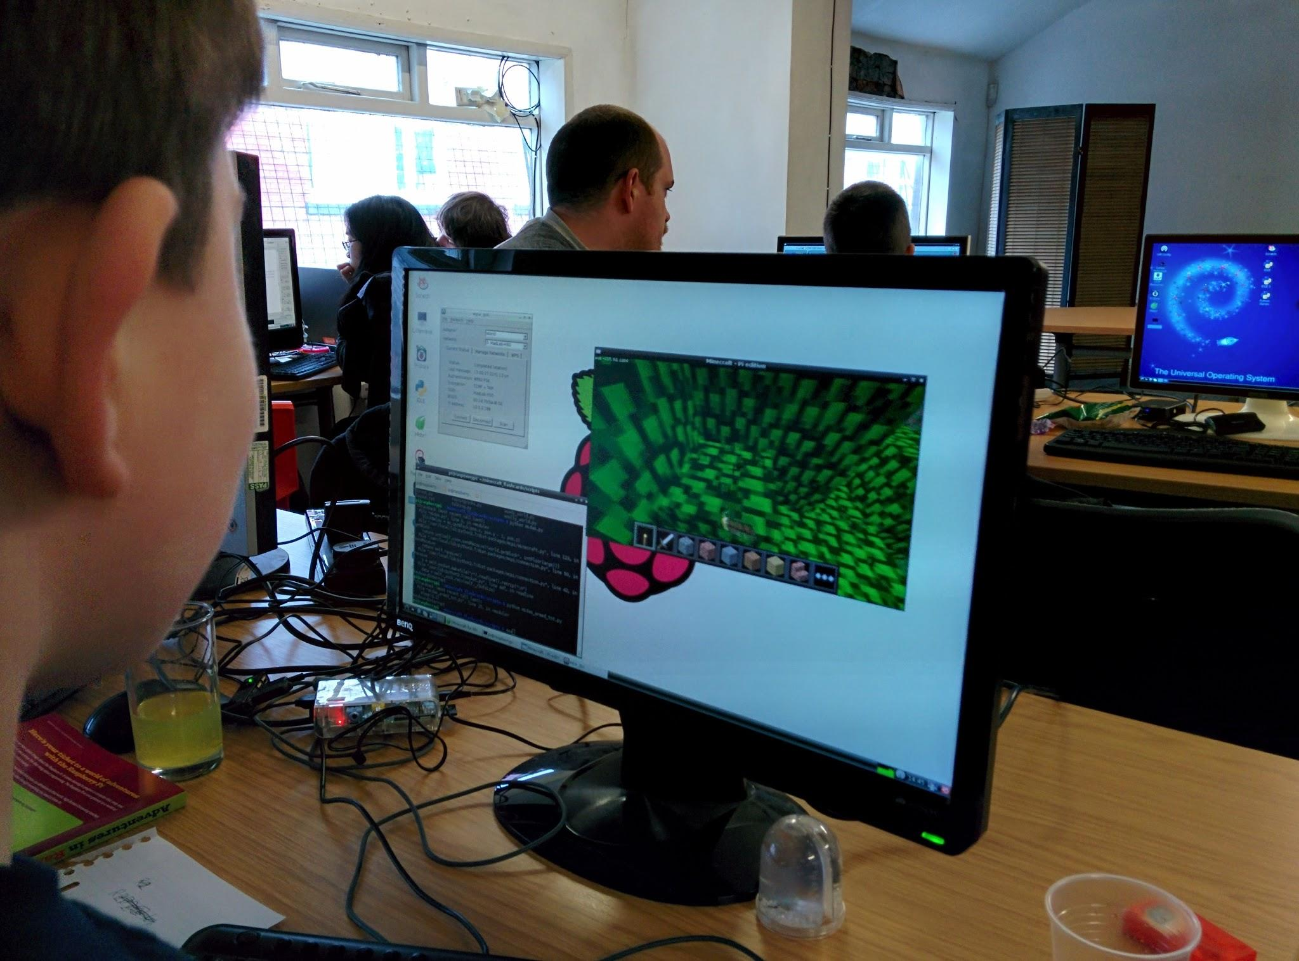
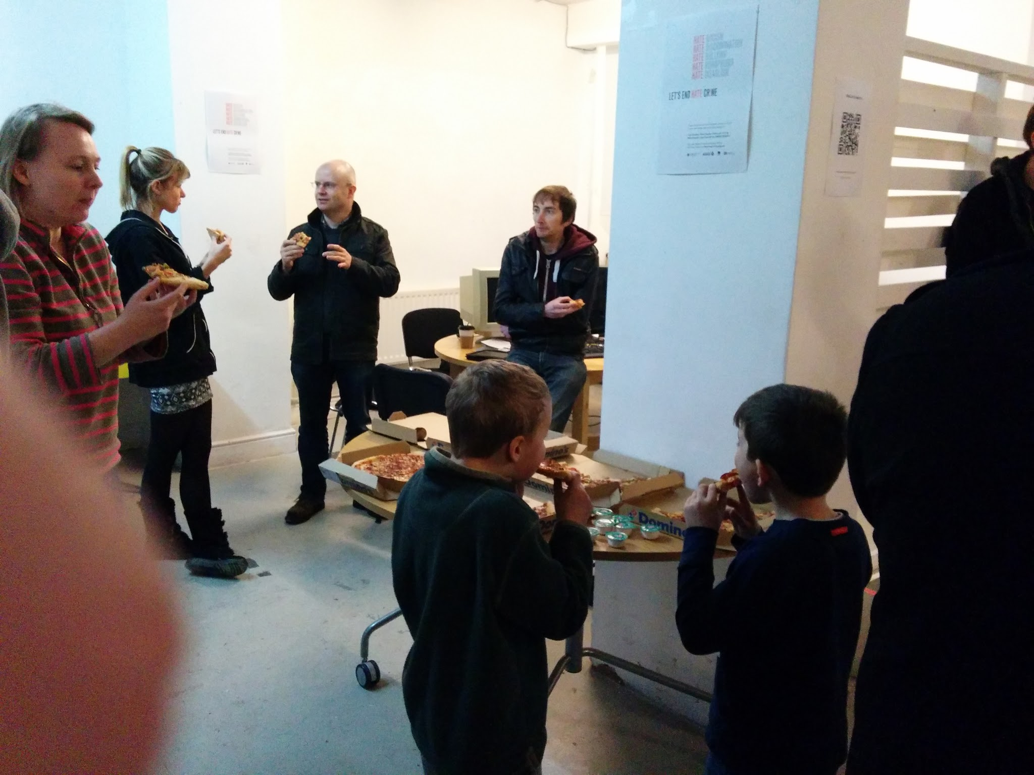
February Jam

Slide 5
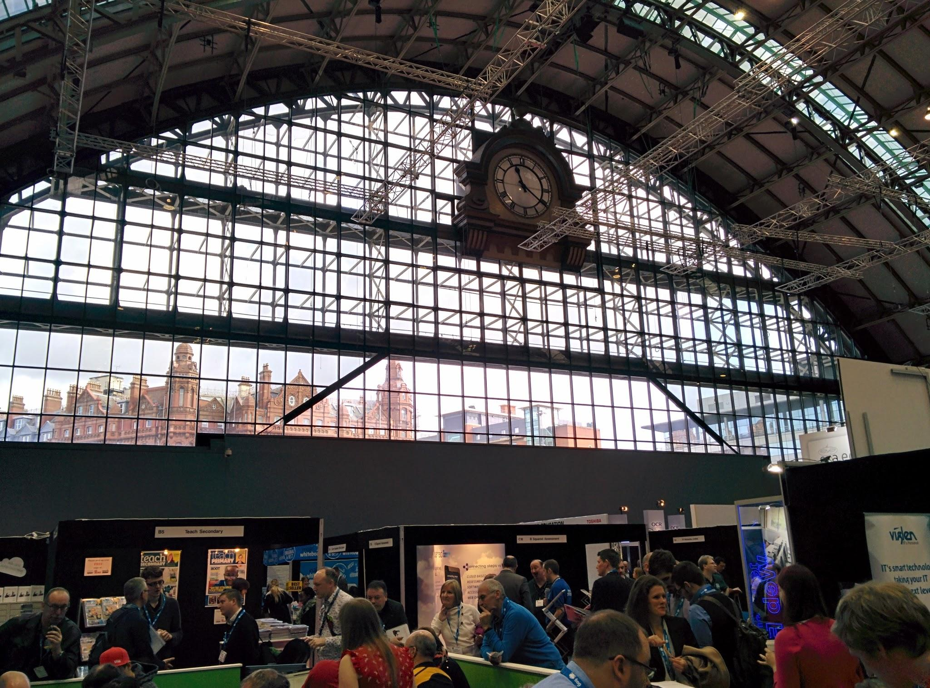
Raspberry Jamboree 2014

Slide 6
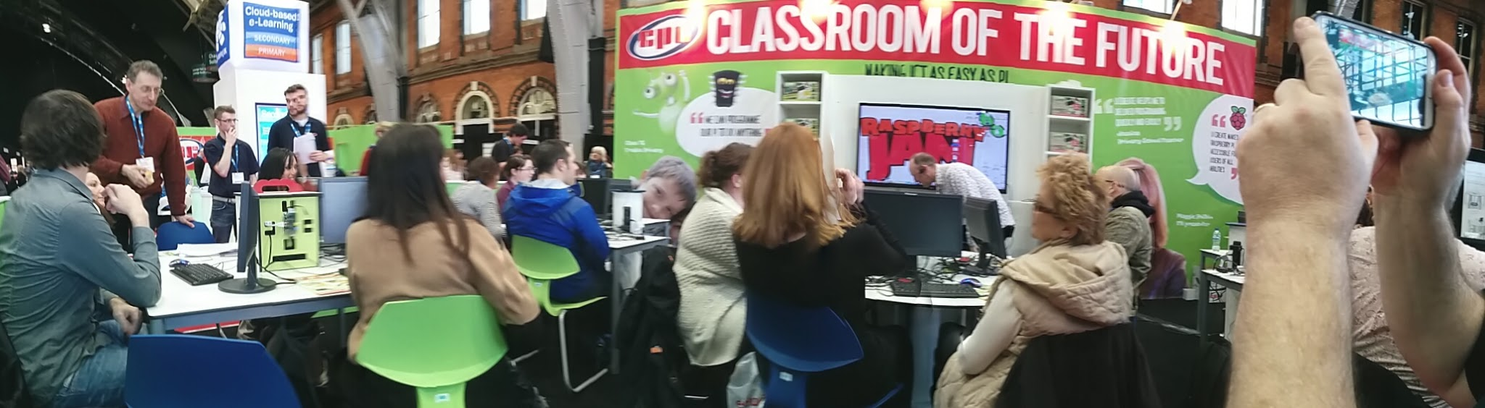
Raspberry Jamboree 2014

Slide 7
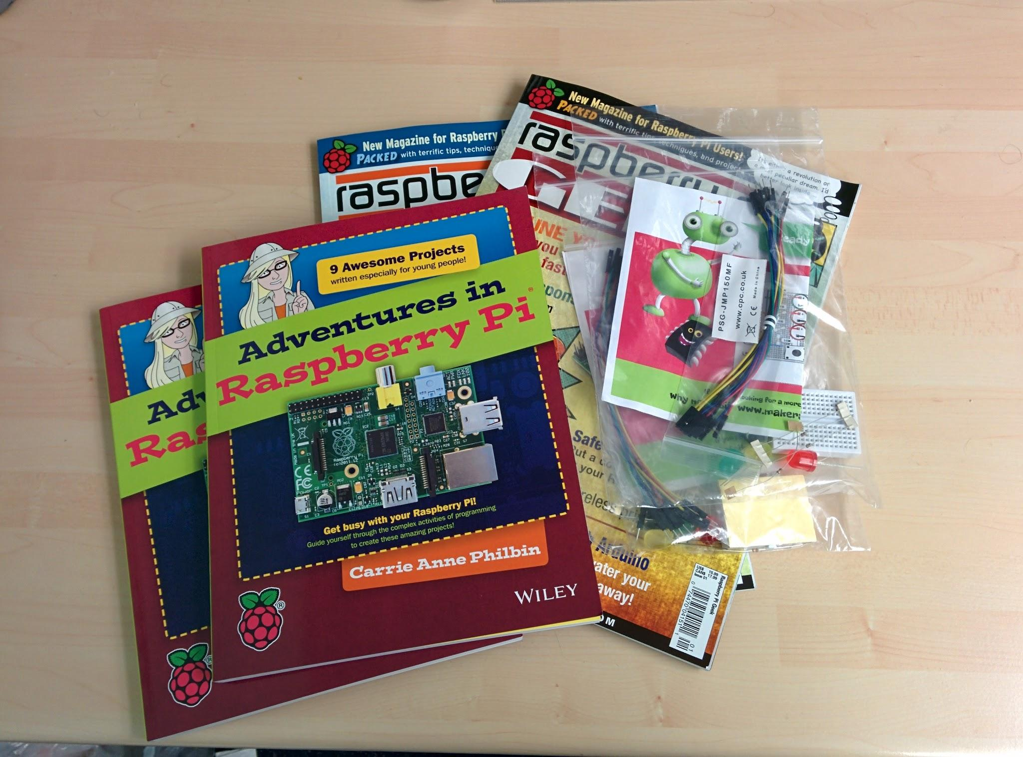
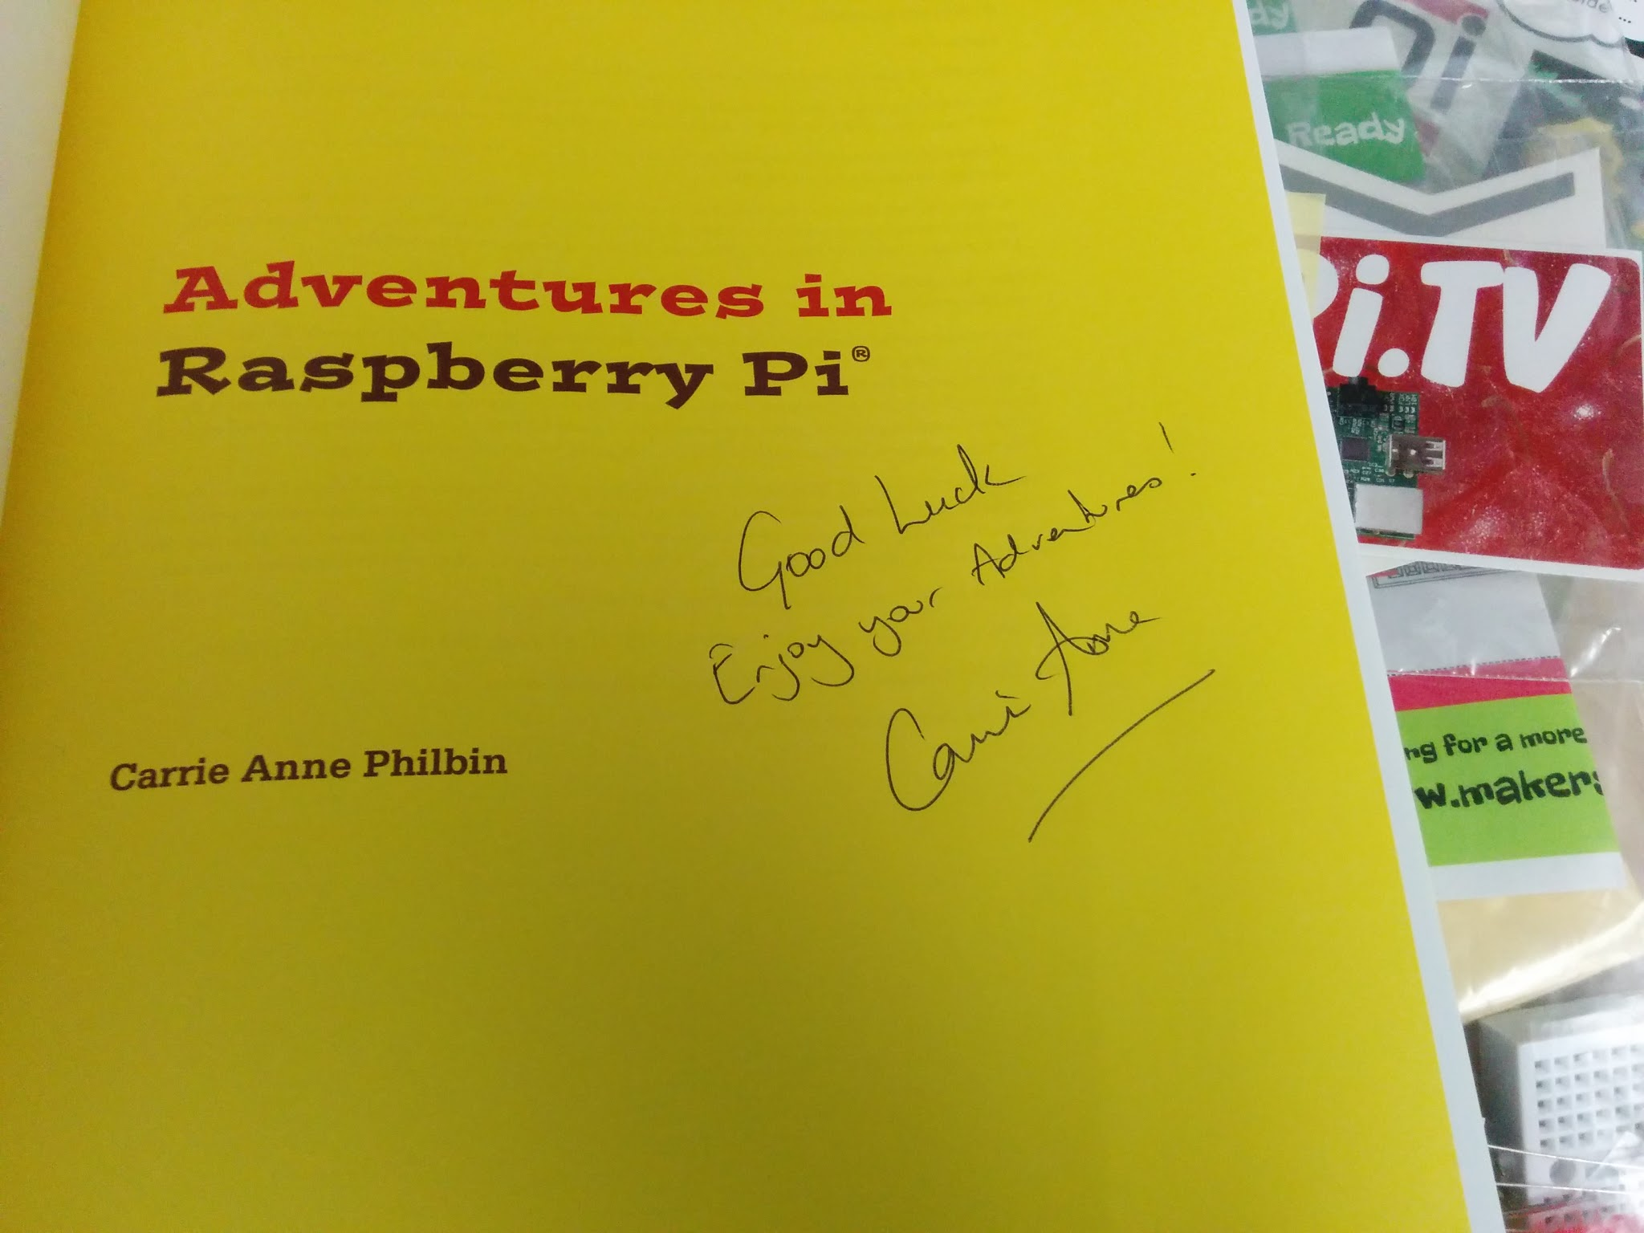
Raspberry Jamboree 2014

Slide 8
In other news

Slide 9

Linux Voice launches
http://www.linuxvoice.com

Slide 10
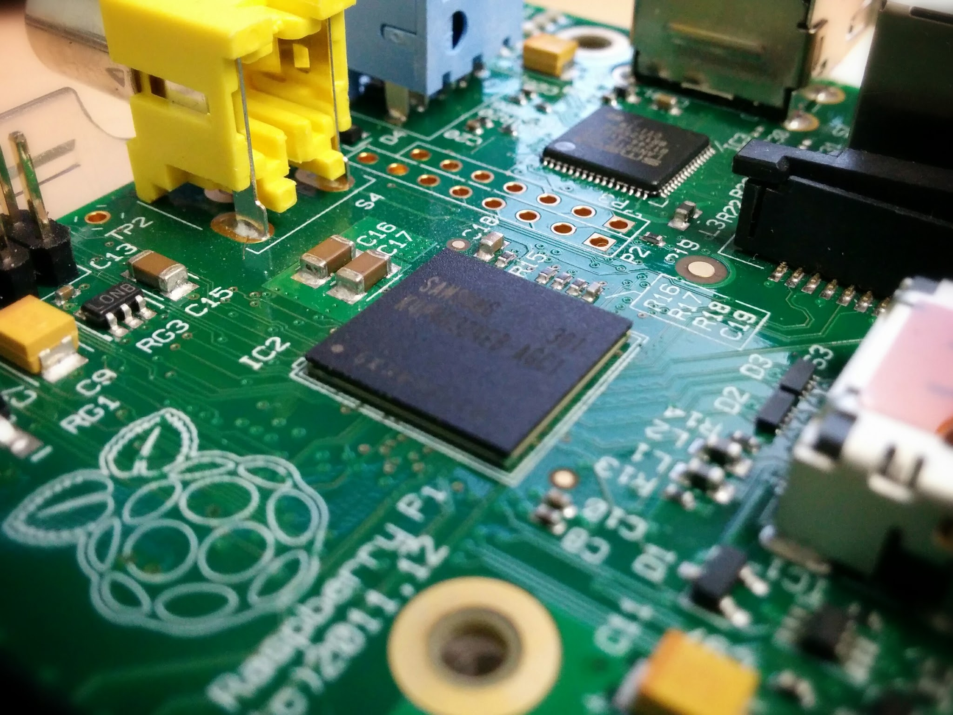
Pi graphics stack
http://blog.broadcom.com/chip-design/android-for-all-broadcom-gives-developers-keys-to-the-videocore-kingdom/

Slide 11
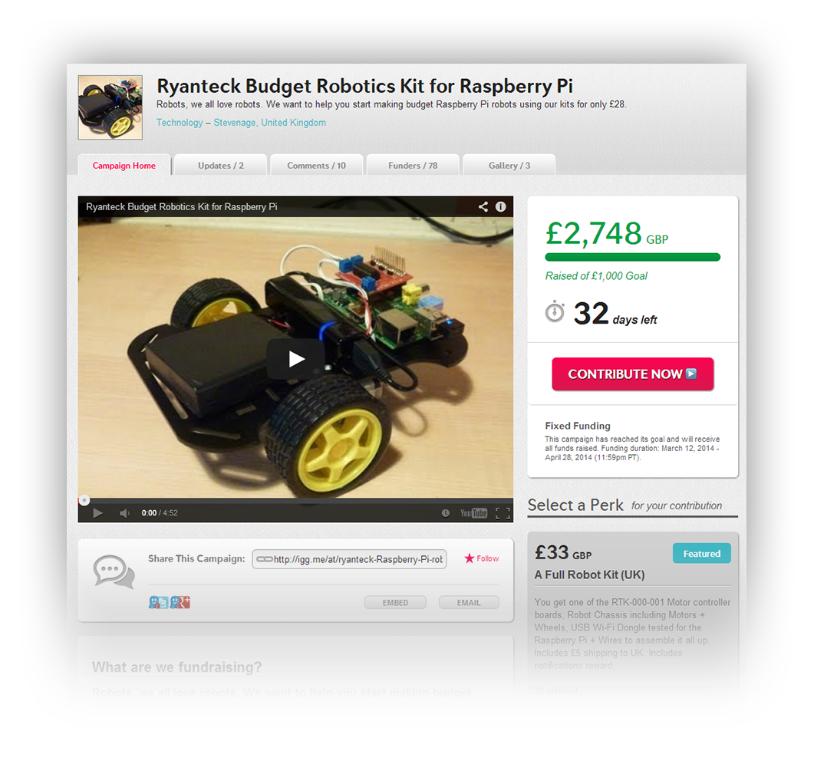
Indiegogo
http://www.indiegogo.com/projects/ryanteck-budget-robotics-kit-for-raspberry-pi

Slide 12
Projects

Slide 13
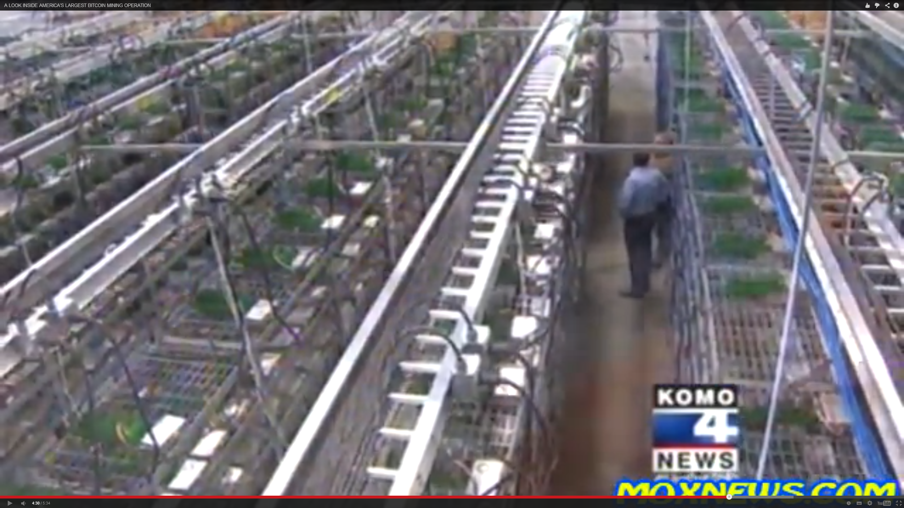
America’s largest Bitcoin
mining operation
http://www.raspberrypi.org/archives/6437

Slide 14
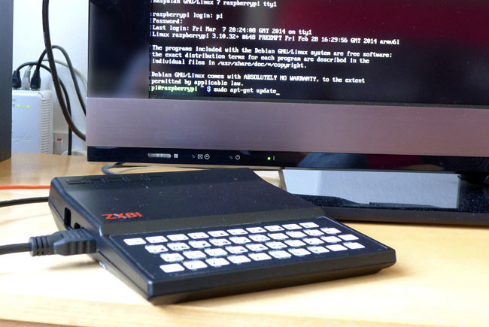
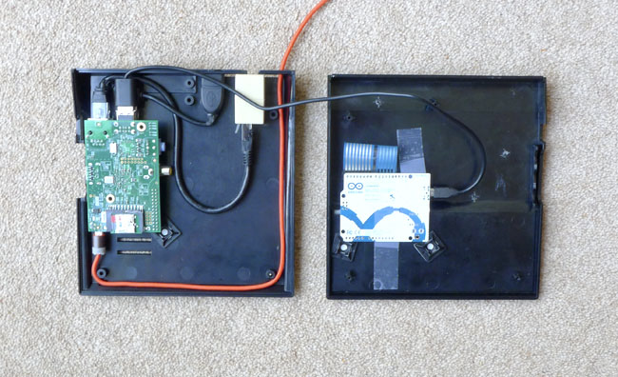
Raspberry ZX81
http://smittytone.wordpress.com/2014/03/15/the-sinclair-zx81-a-raspberry-pi-retro-restyle-part-2/

Slide 15
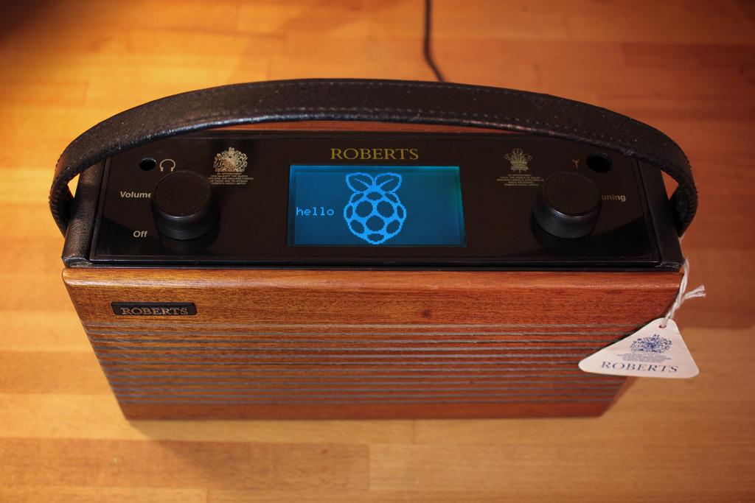
Roberts radio
https://secure.flickr.com/photos/limpfish/13248304854/in/set-72157634474295977/

Slide 16
Coming
Soon...

Slide 17
Next jam:
Nothing Yet =S
(Whenever I haven’t got exams)

Slide 18
For Today...

Slide 19
Drinks provided all day
Pizza at 1pm
Jam ongoing until 5pm
wrapping up at 4:30pm

Slide 20
Talks:
10:30 10:45 - Intro talk
Jack Kelly
11:00-11:45 - The Raspberry Pi journey - 2 years on
Pete Lomas
12:00-12:45 - Home network hacking
Simon Duffy
1:30- 2:00 - Pi projects site (Discussion & feedback)
Andrew Robinson
2:00-2:45 - Design of the Pi
Pete Lomas
3:00-3:30 - Raspberry Pi at the University of Manchester
Jack Kelly

Slide 21
Want to talk?
There are slots available for additional talks:
3:30 - 4:00pm
4:00 - 4:30pm
Add them to the printed schedule!

Slide 22
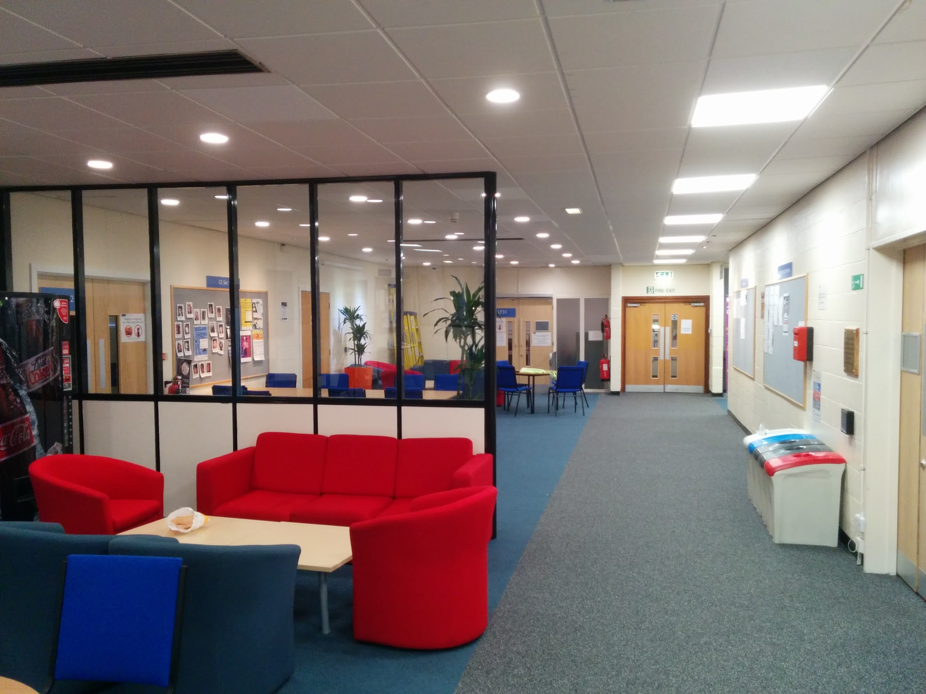
The Rooms

Slide 23
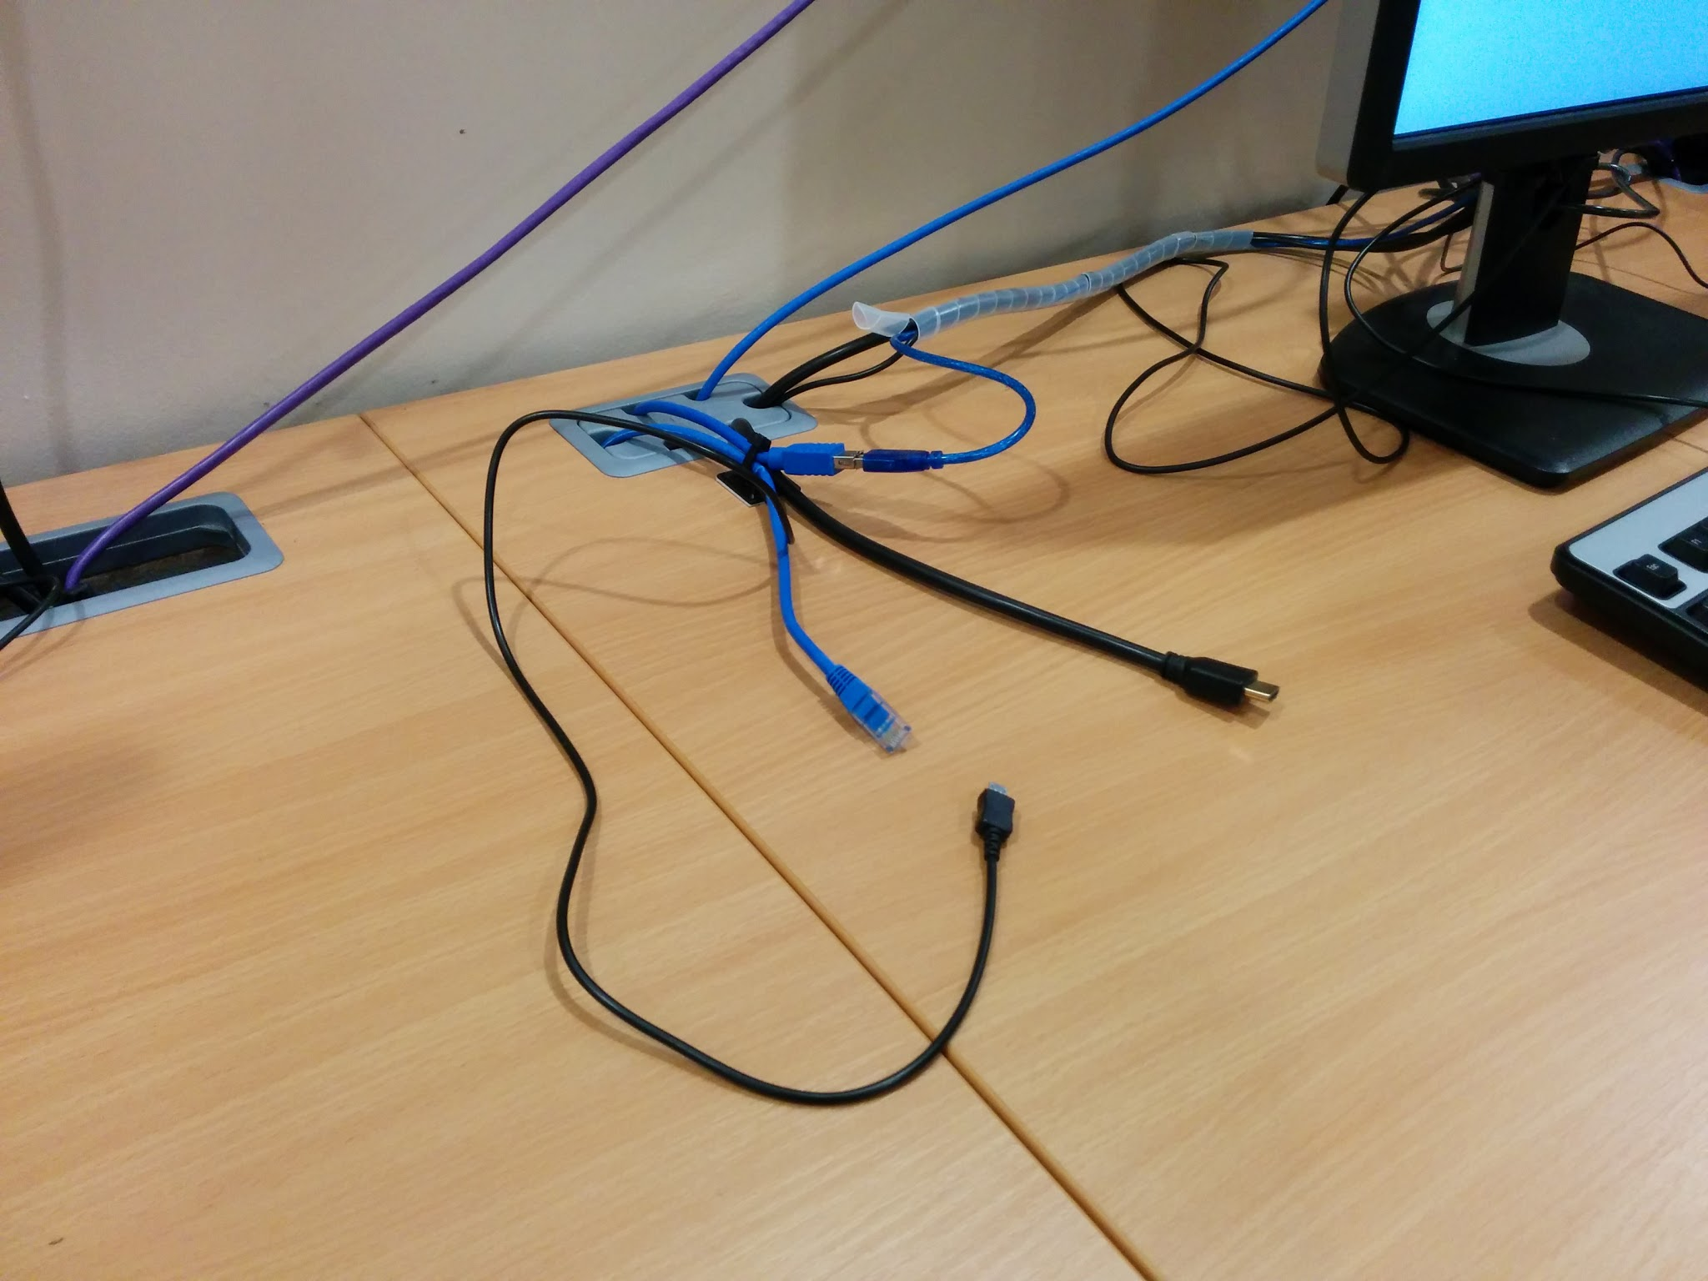
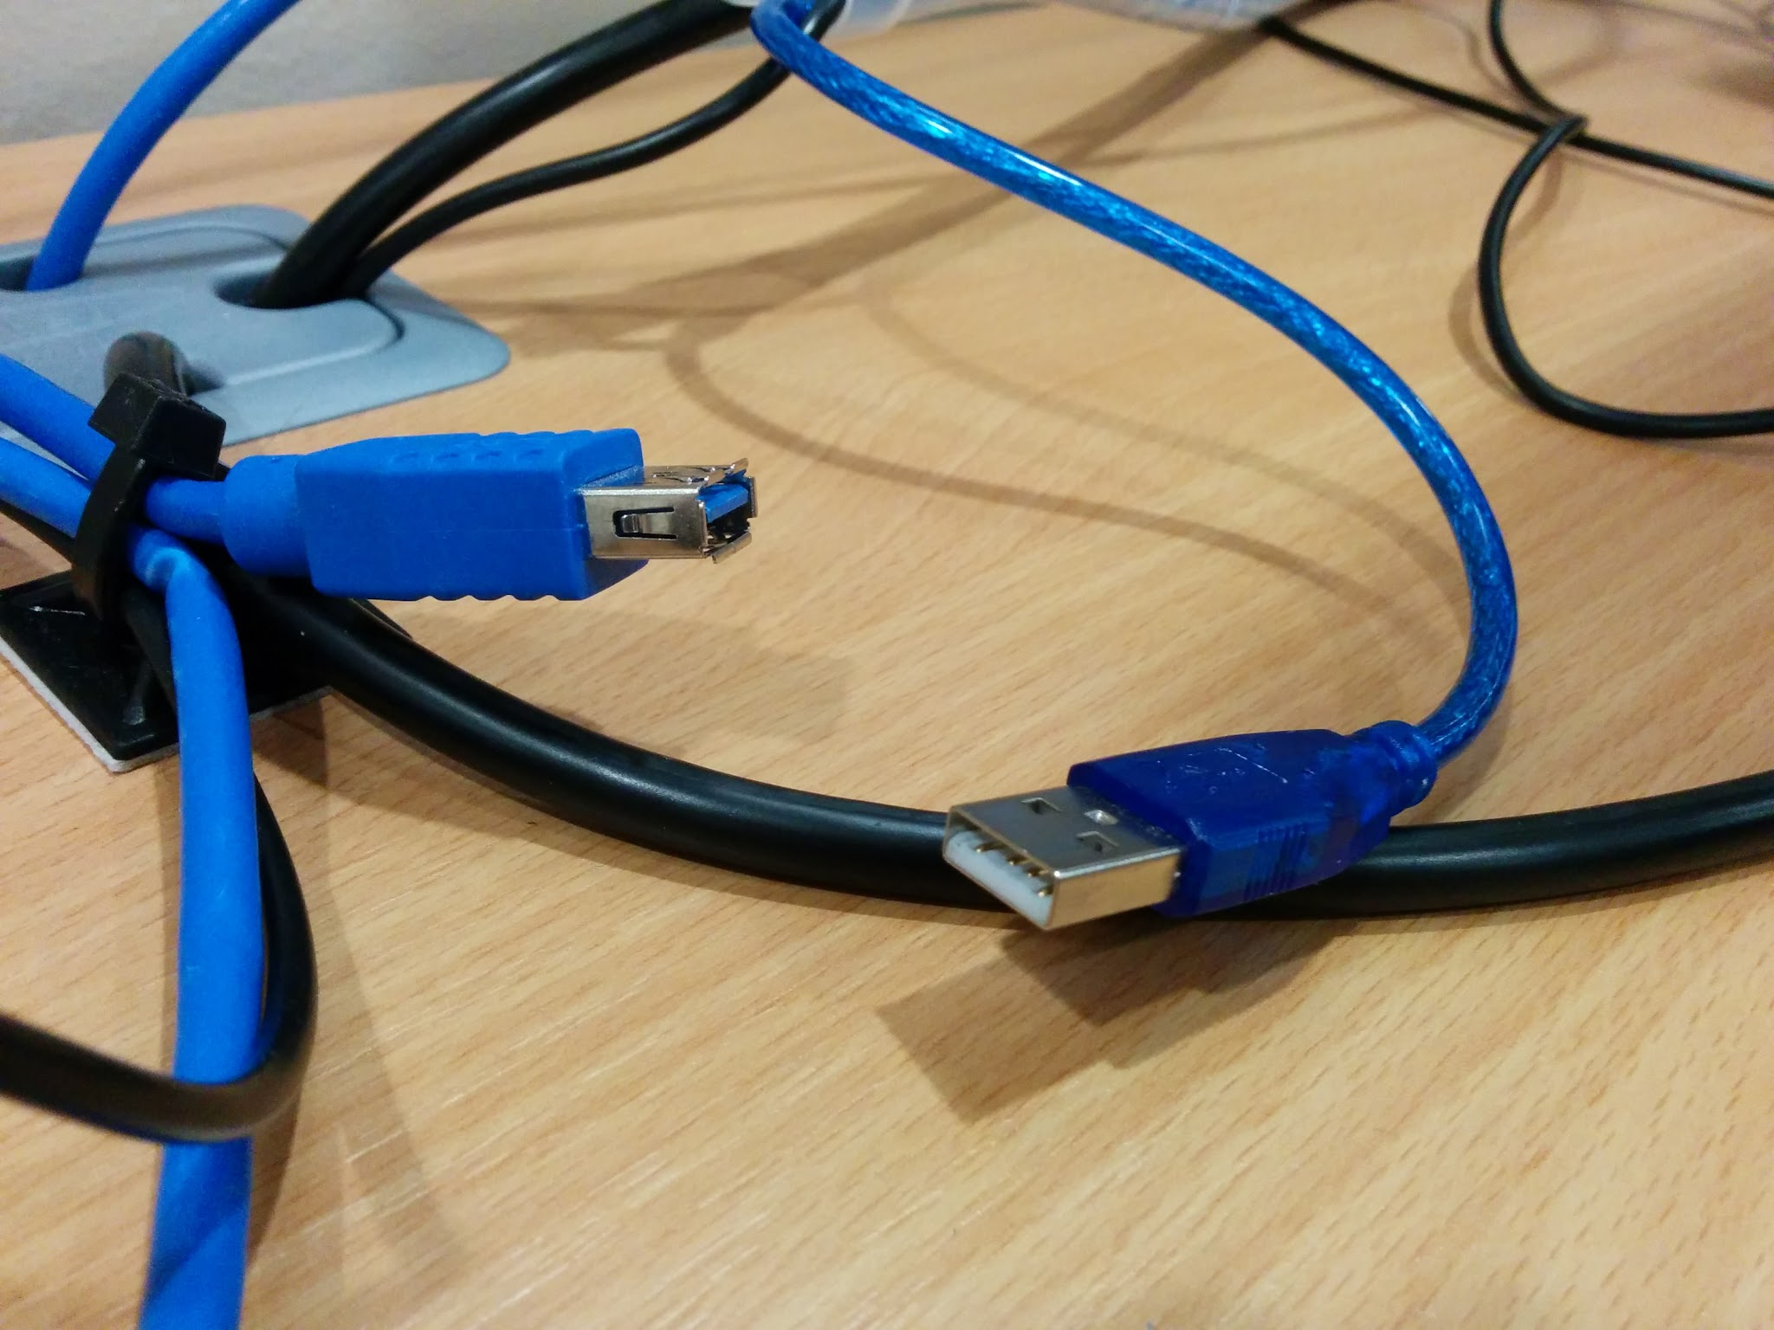
The lab

Slide 25
Thanks to
our Sponsors...

Slide 26
UoM School of Computer Science
For Pizza and space

Slide 27
Community Sponsors:
Bob Breckwoldt Tom Broughton
Elizabeth Howard Dave Jones
Linda Macaulay Michael Rimicans
Simon Walters

Slide 28
And everybody else
Ticket sales have raised
over £100
More Jam Equipment!
(Will be asking for feedback on what to buy)

Slide 29
Finally...
Share your creations and projects.
Have Fun!
Share tweets and photos with:
#McrRaspJam

